Slide 1
JavaScript and the Web

Slide 2
Dynamic HTML
Not a technology in itself
A generic term for technologies used together to created interactive websites
HTML, JS, CSS
Allow changes to a web page after the page has been fully loaded

Slide 3
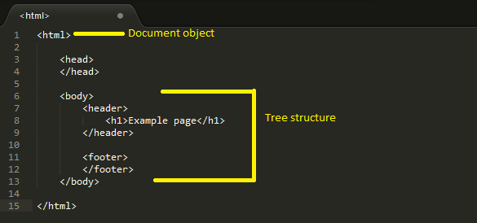
Document Object Model
Cross platform way of representing and interacting with objects in HTML, XHTML, XML
Nodes are organised in a tree structure

Slide 4
Examples

Slide 5
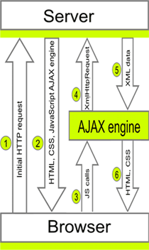
AJAX
Short for Asynchronous JavaScript and XML
A way for web applications to send and retrieve data from a server asynchronously.

